Slide 1
10-k NLP trading strategy
Lucas krenn, hong kong machine learning (hkml)

Slide 2







About the author
Lucas Krenn
Born and raised in Canada
Graduated summa cum laude from McMaster University with an Hons. BSc. in Mathematics & Statistics
Graduated from the University of Toronto’s Master of Mathematical Finance
Most recent role was Quantitative Research Intern at Polar Asset Management Partners
Actively seeking full-time employment opportunities around the world

Slide 3
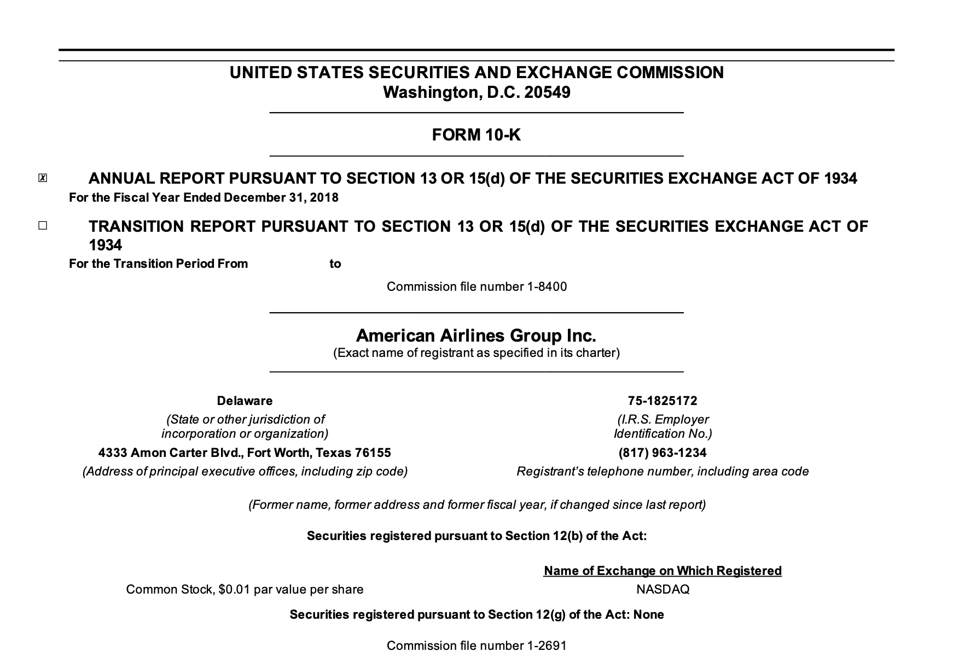
Motivation
Each year, publicly-listed American companies are asked by the SEC to provide investors with annual reports (Form 10-Ks)
Within these forms are information relating to the companies’ financial health, details outlining the performance over the past year, etc.
As with any data, these forms can be ‘squeezed’ for alpha in many ways
e.g. parsing and analyzing KPI results, parsing textual sentiment
IDEA: drastic changes in form 10-Ks can be seen as bearish and not many changes can be seen as bullish

Slide 4
Agenda: the Strategy pipeline
1. Develop a hypothesis
2. Create or obtain datasets
3. Use dataset to generate signal
4. Use signal to construct portfolios
5. Analyze Portfolios and Outcomes
SEC API
Bloomberg
Yahoo Finance
HKML
Equal weight
Target historical volatility
Long/short
Parse 10-K documents to trade drastic changes
Cosine Similarity
Loughran-McDonald
FinBERT
Sharpe
Turnover
Performance relative to benchmark

Slide 5
1. Develop a Hypothesis

Slide 6
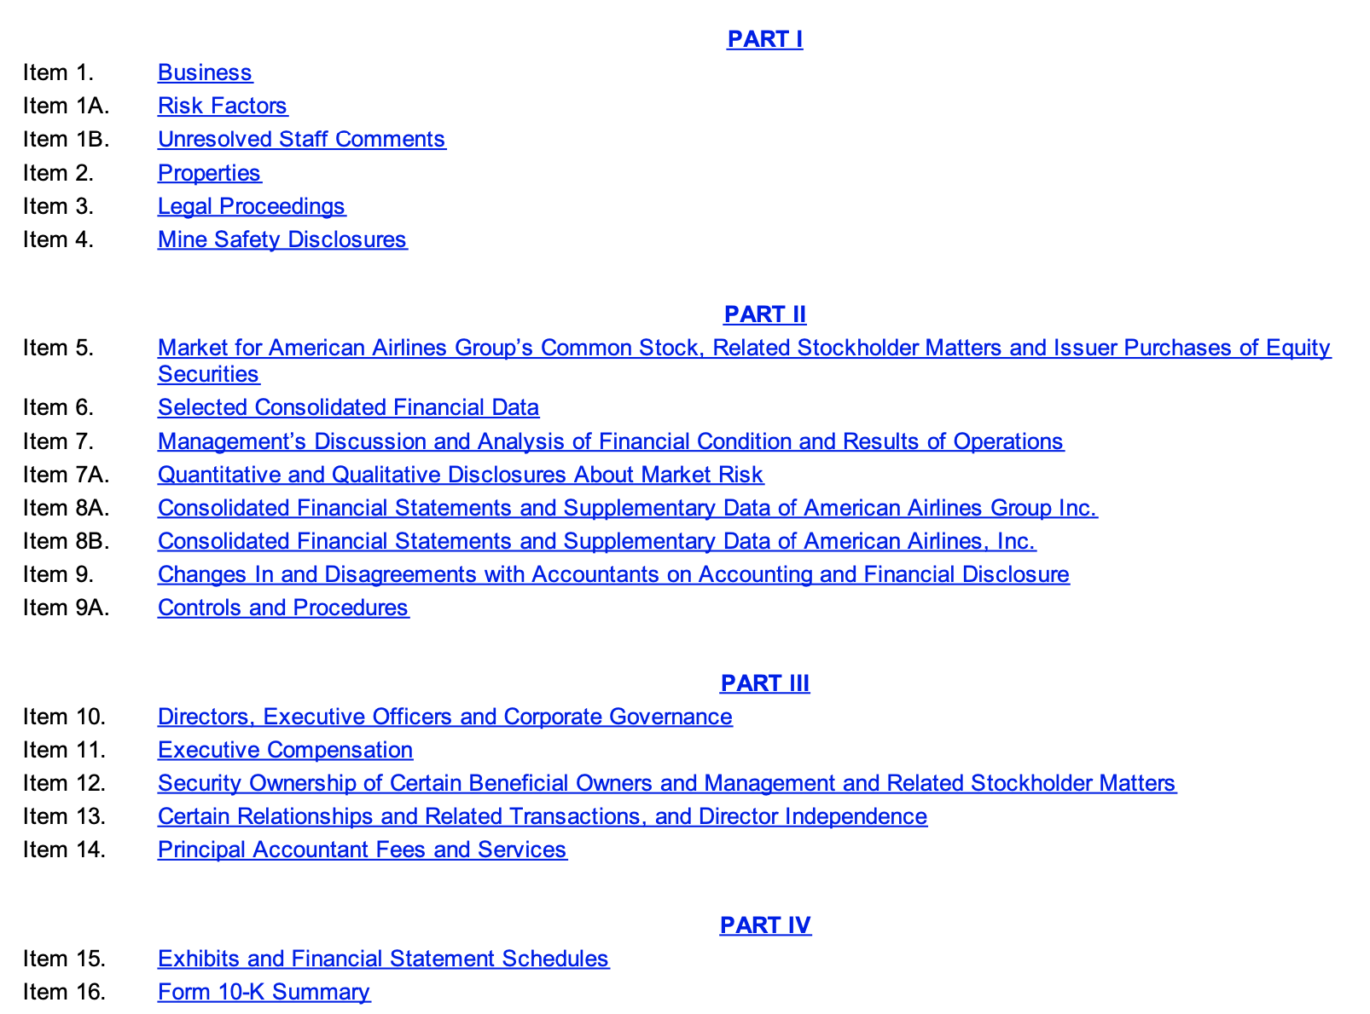
Initial analysis of 10-k
Develop a hypothesis
Before doing any sort of analysis of the data, I needed some priors to give me an idea of how these forms are formatted, the information they contain, and how they are divided
15 sections, each containing different information
Since we are looking to analyze sentiment, two sections in particular stand out:
Item 1A: Risk Factors
Item 7: Management’s Discussion & Analysis

Slide 7
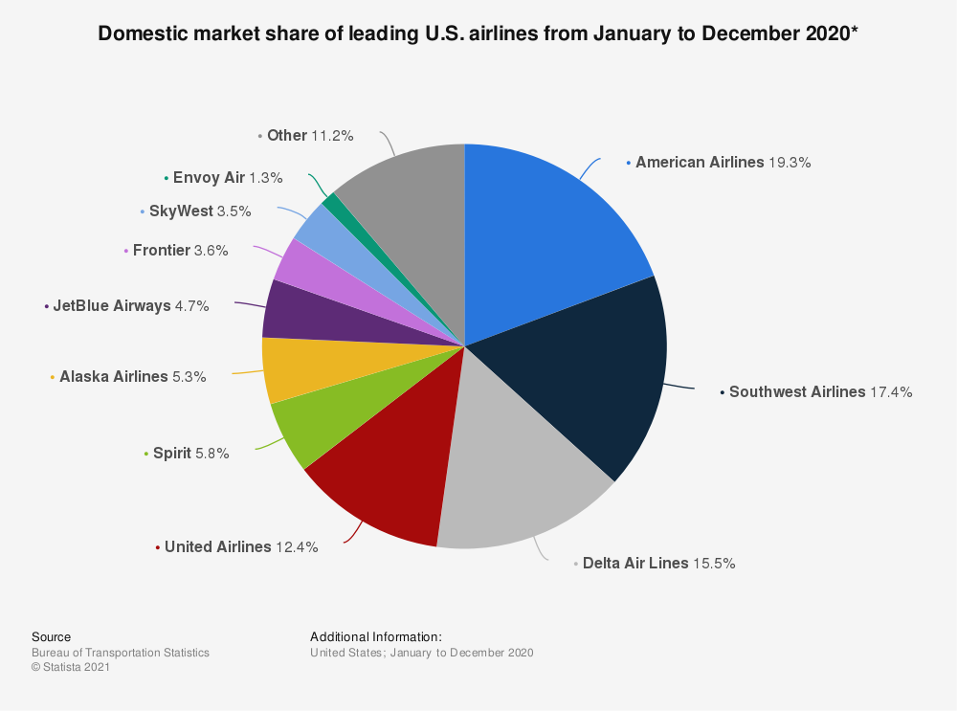
Lesson 1: Remain as general as possible
Develop a hypothesis
Since I wanted to flex my fundamental knowledge a bit, I figured I would immediately jump to only analyzing airlines; this was a mistake
There are only so many airlines that have been publicly traded, and price history data is hard to come by
After all this, I decided to start with a more broad universe and then work my way down, if need be
(Quiz: how many biases can you count just in this one idea?)

Slide 8
2. Create or obtain datasets

Slide 9

Lesson 2: Data can be hard to come by
Develop a hypothesis
Create/obtain datasets
While scraping 10-Ks is extremely easy using the SEC API, finding the necessary equity data is not so easy
Suppose we want all the stocks that have been listed in the S&P 500
Where can an amateur quant find a list of the historical constituents of an index?
Ultimately, I was given a dataset from HKML, since I could not produce a valid list on my own
Data vendors gatekeeping very basic stock data
me

Slide 10
Lesson 3: start with something simple
Develop a hypothesis
Create/obtain datasets
Once my universe was defined, I had to then pull each form using the SEC API, search the documents for each item, and parse the text for these items
This was much harder than it sounds; I tried manually writing a regexp that matched all conditions (how hard could it be?), clustered general regexp matches to see if there was a connection, tried using BeautifulSoup, …
Suppose I found a regexp that matched every case – how would I know which match is in the correct location?

Slide 11
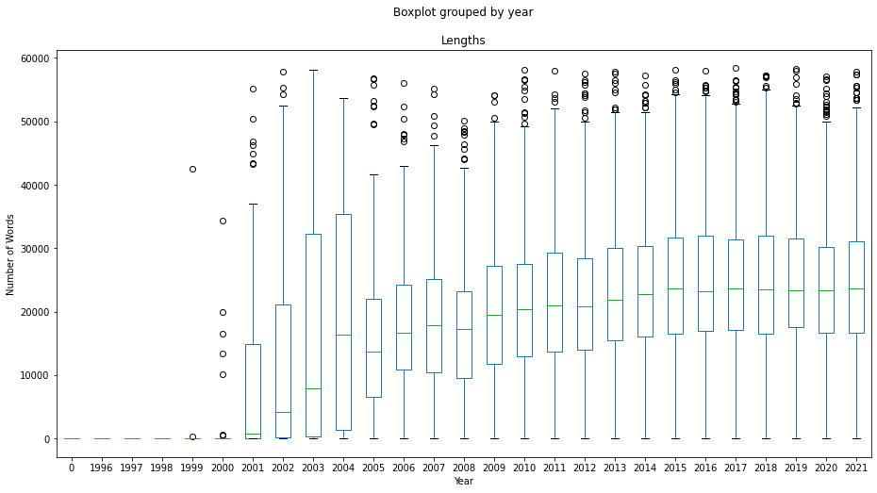
Lesson 3: start with something simple
Develop a hypothesis
Create/obtain datasets
I tried too hard to be fancy, and it turns out that a much simpler answer was much more effective:
By parsing only the text of the document, it is obvious that not many sentences will begin with e.g. Item 7: Management’s Discussion and Analysis, except for the beginning of the excerpt that we need, and in the table of contents

Slide 12
3. Generate a signal

Slide 13



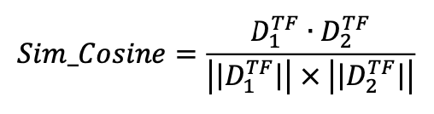
Lesson 3: start with something simple
Develop a hypothesis
Create/obtain datasets
Use dataset to generate signal
As I previously worked with a popular NLP sentiment model, FinBERT, I immediately tried applying it to this problem
It turned out that each sentence took approximately 0.75 seconds for FinBERT to analyze
If a simpler model has absolutely no potential, then chances are something fancy like FinBERT will not as well.
For this reason, I implemented a simpler model found in the popular whitepaper Lazy Prices: Cosine Similarity
Idea: Short companies whose 10-Ks change drastically year-over-year, long companies with few changes

Slide 14
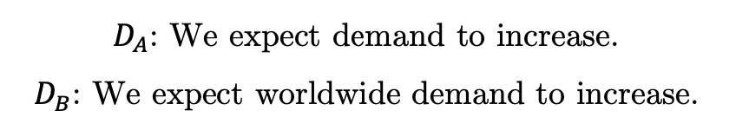
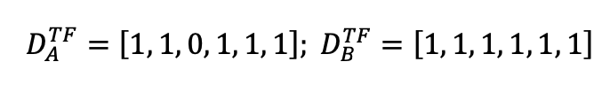
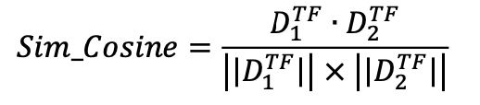
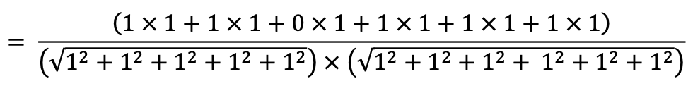
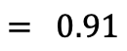
A little bit about cosine similarity
Develop a hypothesis
Create/obtain datasets
Use dataset to generate signal
Step 1: Define our Texts
Step 2: Find all unique words in each text, then construct the union of these two sets
Step 3: Turn our texts into vectors
Step 4: Follow the formula to calculate cosine similarity!

Slide 15
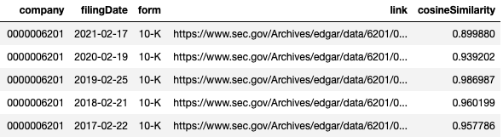
A little bit about cosine similarity
Develop a hypothesis
Create/obtain datasets
Use dataset to generate signal
Step 4: Follow the formula to calculate cosine similarity!
Step 5: Save into DataFrame

Slide 16
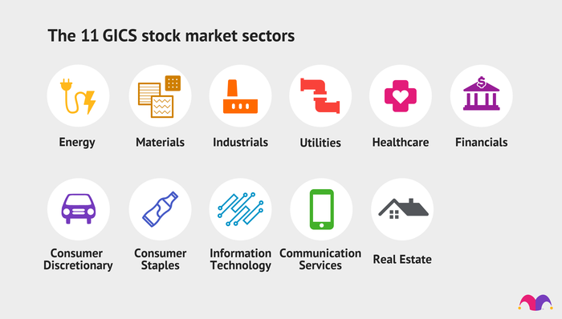
Quick intro to cluster demeaning
Develop a hypothesis
Create/obtain datasets
Use dataset to generate signal
Since not all industries have the same business practices, the returns and signals for companies tend to group together
Want to find these clusters and control for them via cluster demeaning
Can do so using Item 1: Business by embedding these descriptions into a vector and calculating pairwise distances

Slide 17
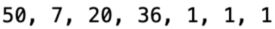
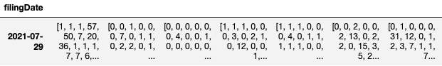
Quick intro to cluster demeaning
Develop a hypothesis
Create/obtain datasets
Use dataset to generate signal
Superset of all words used (cleaned)
[ …
… ]
Create a vector containing the frequency of each word in superset within the business description
[ …
… ]
Do this for each business description, for each applicable date

Slide 18
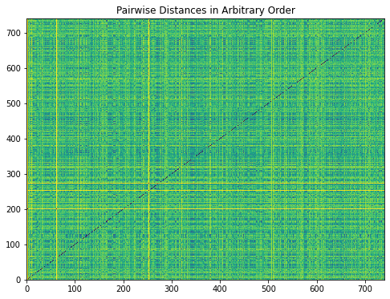
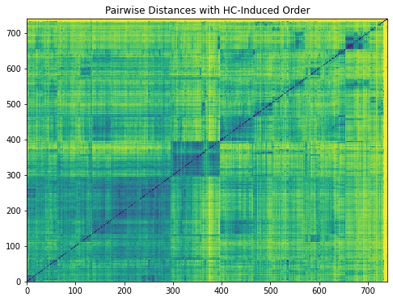
Quick intro to cluster demeaning
Develop a hypothesis
Create/obtain datasets
Use dataset to generate signal
By using hierarchical clustering, we can rearrange the order of companies to find some interesting groupings seen above, and remove their means from the signals

Slide 19
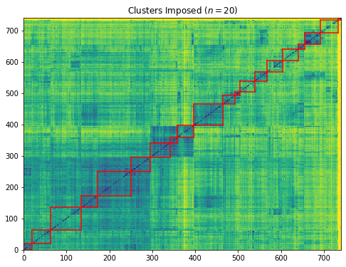
Quick intro to cluster demeaning
Develop a hypothesis
Create/obtain datasets
Use dataset to generate signal
By using hierarchical clustering, we can rearrange the order of companies to find some interesting groupings seen above, and remove their means from the signals

Slide 20
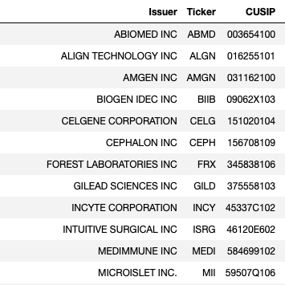
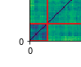
Quick intro to cluster demeaning
Develop a hypothesis
Create/obtain datasets
Use dataset to generate signal
We can validate that the clusters do, indeed, appear to be similar in nature by taking a peek at one such cluster

Slide 21
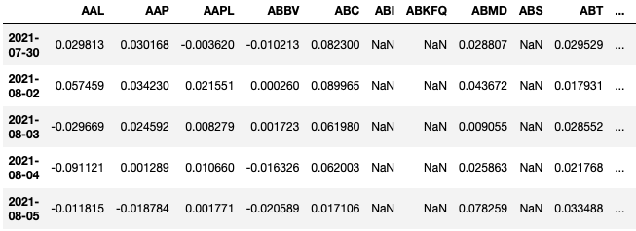
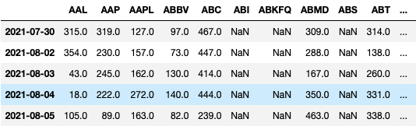
Preliminary analysis
Develop a hypothesis
Create/obtain datasets
Use dataset to generate signal
Generate cosine distances between consecutive documents
Gather all cosine distances into a single dataframe, forward fill
Rank cosine distances based on magnitude
Do the same for returns over a number of periods
Evaluate correlation between the two

Slide 22
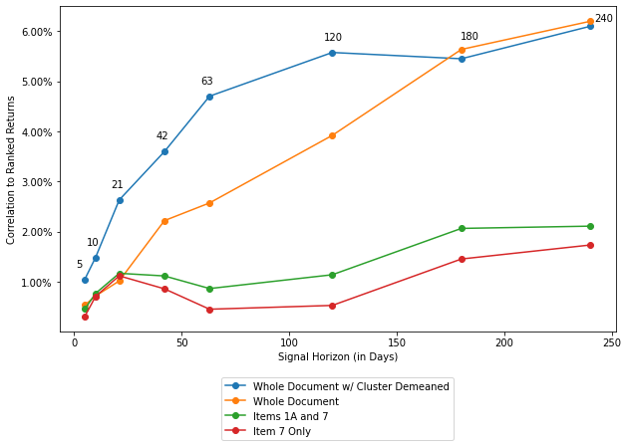
sometimes less more is more
Develop a hypothesis
Create/obtain datasets
Use dataset to generate signal
Recall that we had selected Items 1A and 7 to analyze
Indeed, computational power was part of the reason why, but why else?
Assumptions were imposed and our theoretical set of possible outcomes shrank because of it
Data suggests that perhaps leaving out information is not a good idea

Slide 23
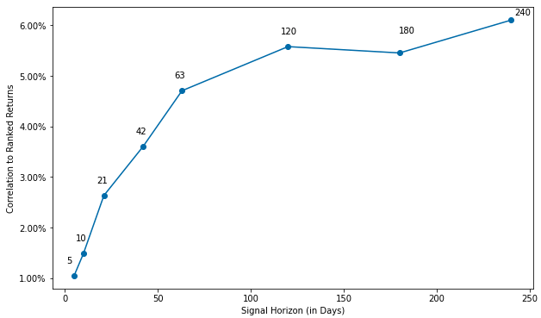
Lesson 4: have some patience
Develop a hypothesis
Create/obtain datasets
Use dataset to generate signal
Since each form comes out once a year, it is important that we rebalance our portfolio very infrequently
Rebalancing too fast means that you will be paying lots of unnecessary transaction costs
Furthermore, the data shows that we need to wait before realizing some alpha!

Slide 24
4. Construct portfolios

Slide 25
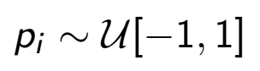
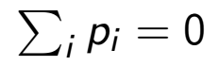
Cosine similarity signal construction
Develop a hypothesis
Create/obtain datasets
Use dataset to generate signal
Use signal to construct portfolios
Date | Stock 1 | Stock 2 | Stock 3
Date 1 | 0.2 | 0.5 | 0.83
Date 2 | 0.35 | 0.42 | 0.90
Date 3 | 0.40 | 0.37 | 0.92
Date | Stock 1 | Stock 2 | Stock 3
Date 1 | 1 | 2 | 3
Date 2 | 1 | 2 | 3
Date 3 | 2 | 1 | 3
Date | Stock 1 | Stock 2 | Stock 3
Date 1 | 1/2 | 3/2 | 5/2
Date 2 | 1/2 | 3/2 | 5/2
Date 3 | 3/2 | 1/2 | 5/2
Step 1: Define your Score
Step 2: Rank your score along the rows
Step 3: Subtract 1/2
Date | Stock 1 | Stock 2 | Stock 3
Date 1 | -2/3 | 0 | 2/3
Date 2 | -2/3 | 0 | 2/3
Date 3 | 0 | -2/3 | 2/3
Date | Stock 1 | Stock 2 | Stock 3
Date 1 | 1/6 | 1/2 | 5/6
Date 2 | 1/6 | 1/2 | 5/6
Date 3 | 1/2 | 1/6 | 5/6
Step 6: Enjoy the nice statistical properties of your portfolio weights!
Step 5: Multiply by 2 and subtract 1
Step 4: Divide by number of scores in each row

Slide 26
5. Analyze outcomes

Slide 27
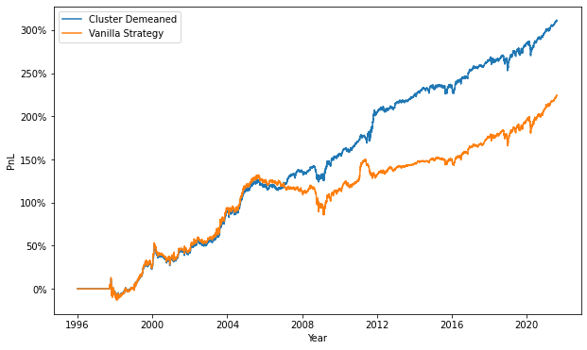
Constructing a portfolio using cosine similarity
Develop a hypothesis
Create/obtain datasets
Use dataset to generate signal
Use signal to construct portfolios
Analyze Portfolios and Outcomes
 | De-Meaned | Vanilla
PnL | 311.17% | 224.09%
Ann. Return | 6.1% | 5.0%
Sharpe | 1.00 | 0.73
Max DD | (26.21%) | (29.88%)
At first glance, the perfect-world portfolio looks to be promising!

Slide 28
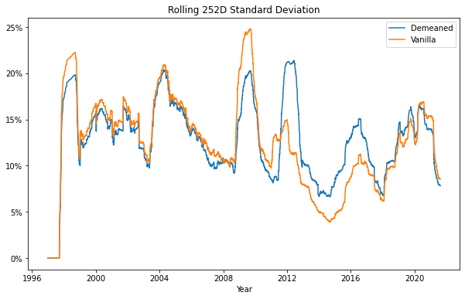
Analysis of portfolio volatility
Develop a hypothesis
Create/obtain datasets
Use dataset to generate signal
Use signal to construct portfolios
Analyze Portfolios and Outcomes
 | Mean
Demeaned | 12.79%
Vanilla | 12.56%

Slide 29
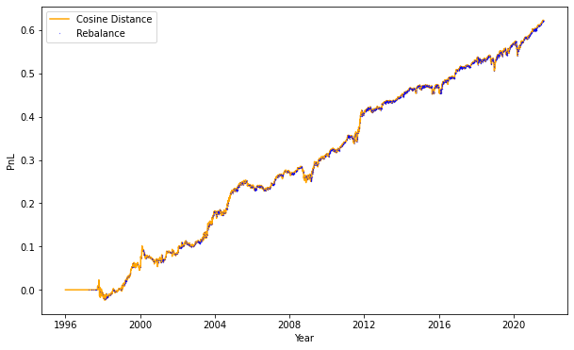
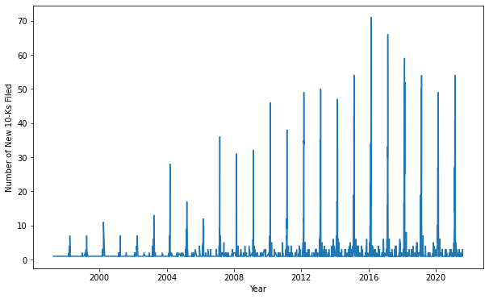
Analysis of turnover
Develop a hypothesis
Create/obtain datasets
Use dataset to generate signal
Use signal to construct portfolios
Analyze Portfolios and Outcomes
We can see that many companies report on the same day early-on in the year
Note: number of new reports not reflected on left chart
High number of reports by approx. Q1 end means theoretically low penalty for rebalancing once p.a.

Slide 30
Next steps
Try a couple of other scoring methods (Loughran McDonald Word Count, Multiprocessor FinBERT?
Try different embeddings for Item 1: Business
Portfolio optimization (Mean-variance optimization, etc.)
Include real-world scenarios (t-costs, slippage, infrequent rebalancing)
Implement in Darwinex?

Slide 31
Thank you!

